Slide 1
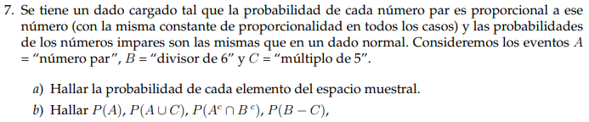

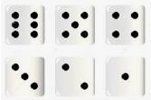

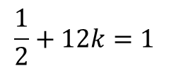
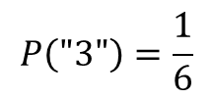
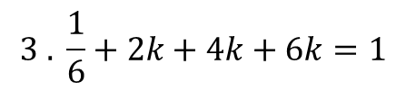
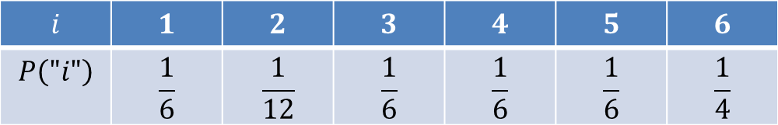
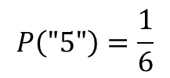
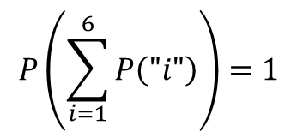
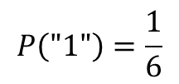



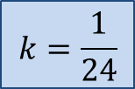
$$a)$$
$$P\left(\text{"5"}\right)=\frac{1}{6}$$
$$P\left(\text{"6"}\right)=6k$$
$$P\left(\text{"4"}\right)=4k$$
$$P\left(\text{"1"}\right)=\frac{1}{6}$$
$$P\left(\text{"3"}\right)=\frac{1}{6}$$
$$P\left(\text{"2"}\right)=2k$$
$$P\left(\sum_{i=1}^{6}{P\left("i"\right)}\right)=1$$
$$3 . \frac{1}{6}+2k+4k+6k=1$$
$$\frac{1}{2}+12k=1$$
$$k=\frac{1}{24}$$
$$i$$ | $$1$$ | $$2$$ | $$3$$ | $$4$$ | $$5$$ | $$6$$
$$P\left("i"\right)$$ | $$\frac{1}{6}$$ | $$\frac{1}{12}$$ | $$\frac{1}{6}$$ | $$\frac{1}{6}$$ | $$\frac{1}{6}$$ | $$\frac{1}{4}$$

Slide 2








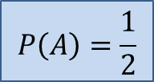




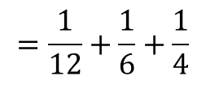



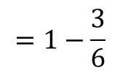


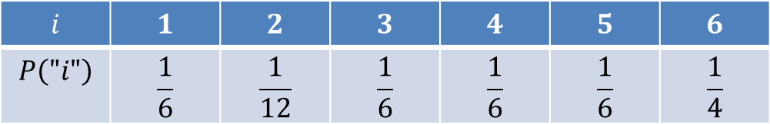




$$i$$ | $$1$$ | $$2$$ | $$3$$ | $$4$$ | $$5$$ | $$6$$
$$P\left("i"\right)$$ | $$\frac{1}{6}$$ | $$\frac{1}{12}$$ | $$\frac{1}{6}$$ | $$\frac{1}{6}$$ | $$\frac{1}{6}$$ | $$\frac{1}{4}$$
$$b)$$
$$A=\left\{2;4;6\right\}$$
$$B=\left\{1;2;3;6\right\}$$
$$C=\left\{5\right\}$$
¿Podría aplicarse la Fórmula de Laplace?
$$S$$
$$P\left(A\right)=???$$
$$A$$
$$2$$
$$1$$
$$B$$
$$4$$
$$6$$
$$3$$
No!!!
Los resultados no son equiprobables
$$5$$
$$C$$
$$=\frac{1}{12}+\frac{1}{6}+\frac{1}{4}$$
$$P\left(A\right)=\frac{1}{2}$$
$$P\left(A\right)=$$
$$P\left(\left\{2\right\}\right)$$
$$+P\left(\left\{4\right\}\right)$$
$$+P\left(\left\{6\right\}\right)$$
$$Observación:$$
$$P\left(A\right)=1−P\left(\overline{A }\right)$$
$$=1−\frac{3}{6}$$
Fórmula de Laplace
n° Impar
Los resultados son equiprobables

Slide 3



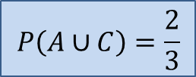
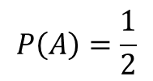
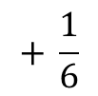
$$i$$ | $$1$$ | $$2$$ | $$3$$ | $$4$$ | $$5$$ | $$6$$
$$P\left("i"\right)$$ | $$\frac{1}{6}$$ | $$\frac{1}{12}$$ | $$\frac{1}{6}$$ | $$\frac{1}{6}$$ | $$\frac{1}{6}$$ | $$\frac{1}{4}$$
$$b)$$
$$A=\left\{2;4;6\right\}$$
$$B=\left\{1;2;3;6\right\}$$
$$C=\left\{5\right\}$$
$$P\left(A\right)=\frac{1}{2}$$
$$S$$
$$A$$
$$2$$
$$1$$
$$B$$
$$+ \frac{1}{6}$$
$$4$$
$$6$$
$$3$$
$$P\left(A∪C\right)=$$
$$P\left(A\right)+P\left(C\right)$$
$$=\frac{1}{2}$$
$$5$$
$$C$$
Son M.E.
$$P\left(A∪C\right)=\frac{2}{3}$$

Slide 4


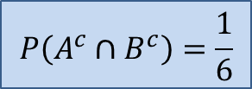


$$i$$ | $$1$$ | $$2$$ | $$3$$ | $$4$$ | $$5$$ | $$6$$
$$P\left("i"\right)$$ | $$\frac{1}{6}$$ | $$\frac{1}{12}$$ | $$\frac{1}{6}$$ | $$\frac{1}{6}$$ | $$\frac{1}{6}$$ | $$\frac{1}{4}$$
$$b)$$
$$A=\left\{2;4;6\right\}$$
$$B=\left\{1;2;3;6\right\}$$
$$C=\left\{5\right\}$$
$$S$$
$$A$$
$$2$$
$$1$$
$$B$$
$$4$$
$$6$$
$$3$$
$$P\left(A^{c}∩B^{c}\right)=???$$
$$5$$
$$C$$
$$A^{c}∩B^{c}=\overline{ A∪B}$$
$$=C$$
$$P\left(A^{c}∩B^{c}\right)=P\left(C\right)$$
$$P\left(A^{c}∩B^{c}\right)=\frac{1}{6}$$

Slide 5








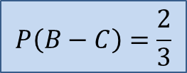
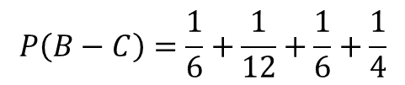
$$i$$ | $$1$$ | $$2$$ | $$3$$ | $$4$$ | $$5$$ | $$6$$
$$P\left("i"\right)$$ | $$\frac{1}{6}$$ | $$\frac{1}{12}$$ | $$\frac{1}{6}$$ | $$\frac{1}{6}$$ | $$\frac{1}{6}$$ | $$\frac{1}{4}$$
$$b)$$
$$A=\left\{2;4;6\right\}$$
$$B=\left\{1;2;3;6\right\}$$
$$C=\left\{5\right\}$$
$$S$$
$$A$$
$$2$$
$$1$$
$$B$$
$$4$$
$$6$$
$$3$$
$$P\left(B−C\right)=???$$
$$5$$
$$C$$
$$B−C=B∩C^{c}$$
$$=B$$
$$P\left(B−C\right)=P\left(B\right)$$
$$=P\left(\left\{1\right\}\right)$$
$$+P\left(\left\{2\right\}\right)$$
$$+P\left(\left\{3\right\}\right)$$
$$+P\left(\left\{6\right\}\right)$$
$$P\left(B−C\right)=\frac{1}{6}+\frac{1}{12}+\frac{1}{6}+\frac{1}{4}$$
$$P\left(B−C\right)=\frac{2}{3}$$

